Slide 1
EARTHQUAKE
DATA VISUALISATION

Slide 2
Introduction
In this project, we explore and visualise global earthquake activity based on seismic data recorded over a one-month period. The data set includes information about the location, magnitude, depth, type of each earthquake and the time it occurred.
Using various data visualisation techniques such as Bar chart, Pie chart and Scatter plot to provide insights into the global activity and help understanding the scale, frequency and location during the data set time period.

Slide 3
Introduction of DATA SET
Remote source : https://earthquake.usgs.gov/earthquakes/feed/v1.0/summary/all_month.csv
Time : the exact timestamp when the earthquake occurred (UTC)
Latitude : geographic latitude where the earthquake originated.
Longitude : geographic longitude of the earthquake’s epicentre.
Depth : how deep the earthquake was beneath Earth’s surface (in Kilometers)
Mag : Magnitude of the earthquake in Richter scale.
Net : the network code of the organisation that reported the data.
Type : classification of earthquake - earthquake, quarry blast, explosion etc.
Credit:USGS.gov

Slide 4
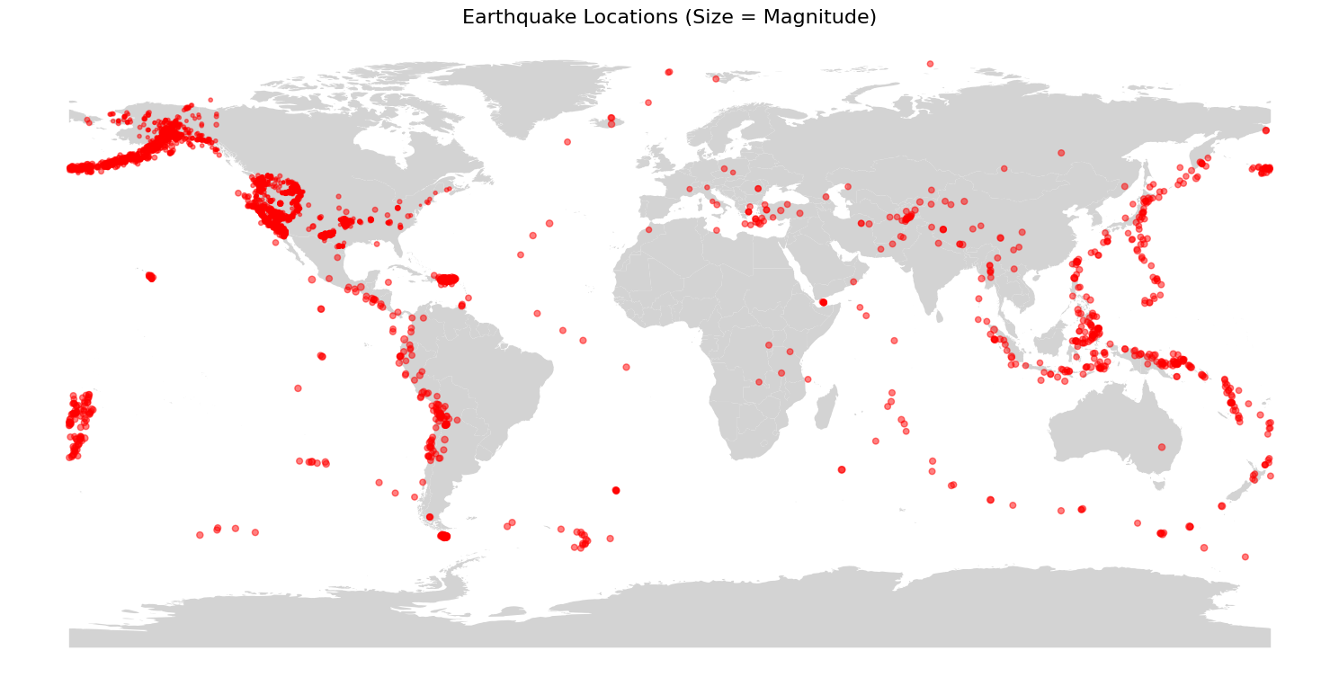

Slide 5
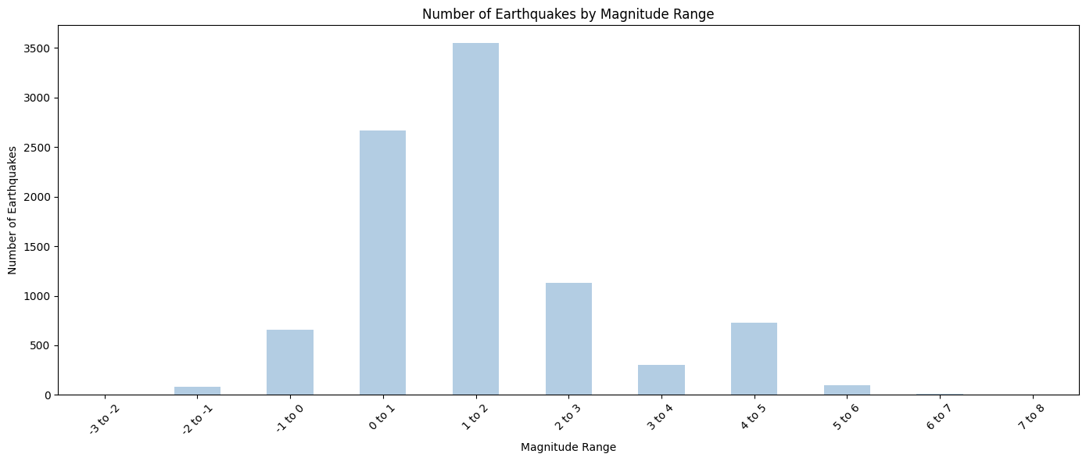

Slide 6
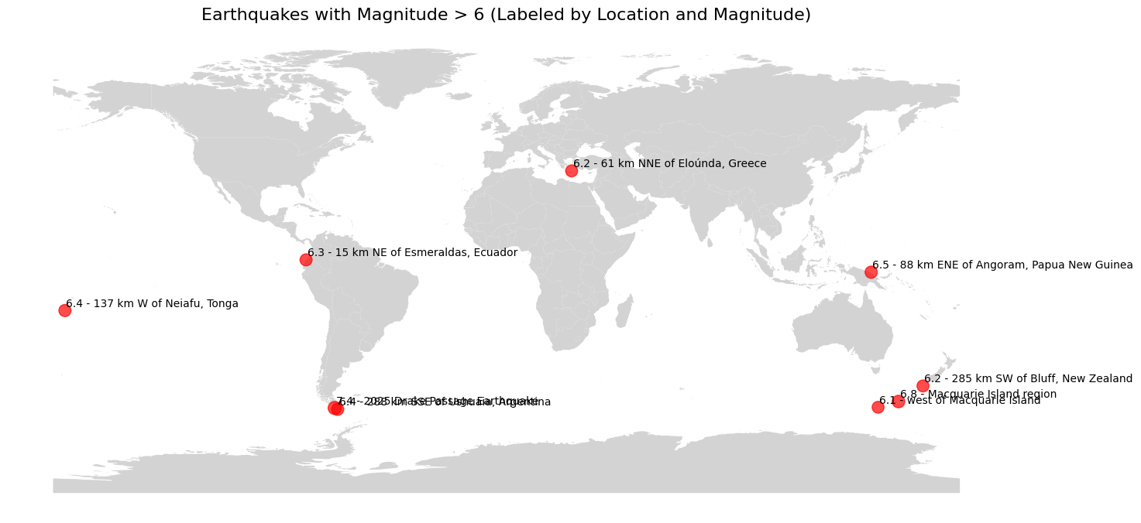

Slide 7
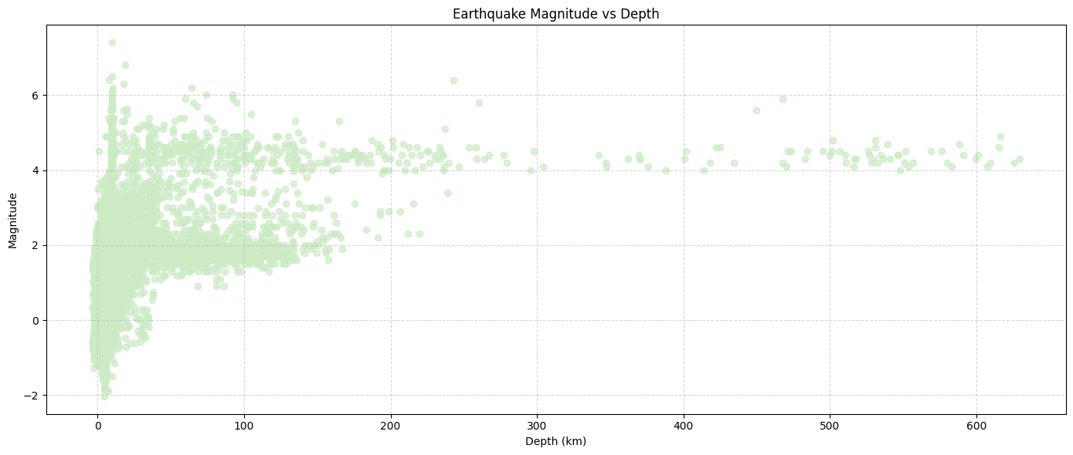

Slide 8
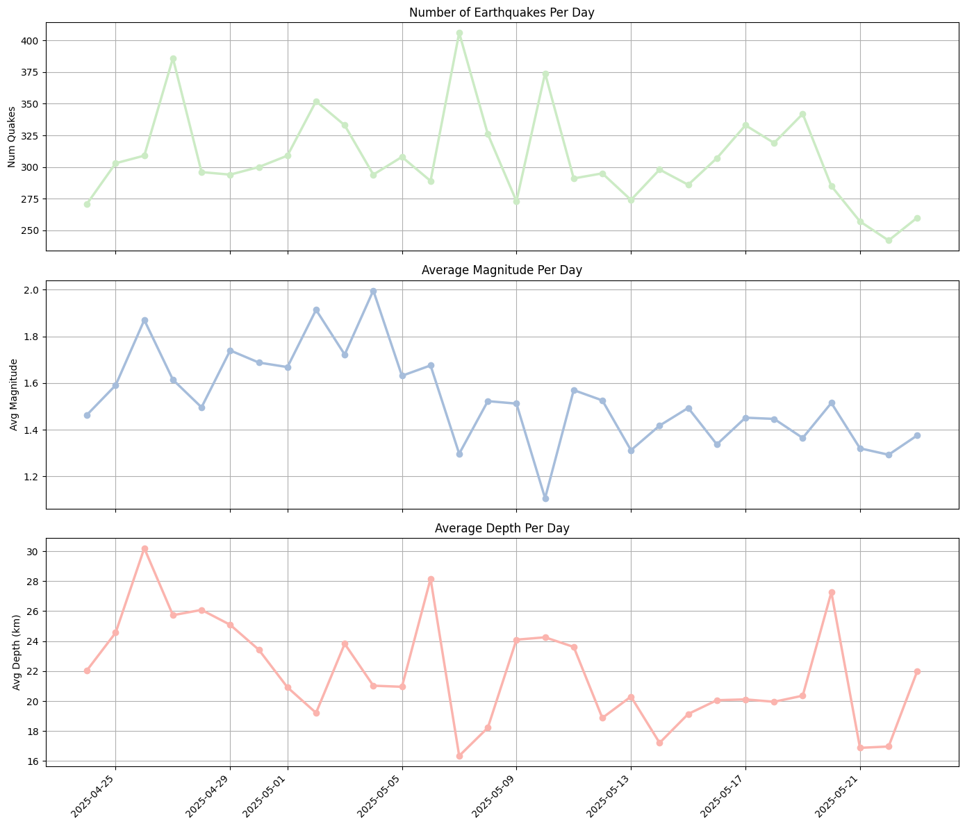

Slide 9
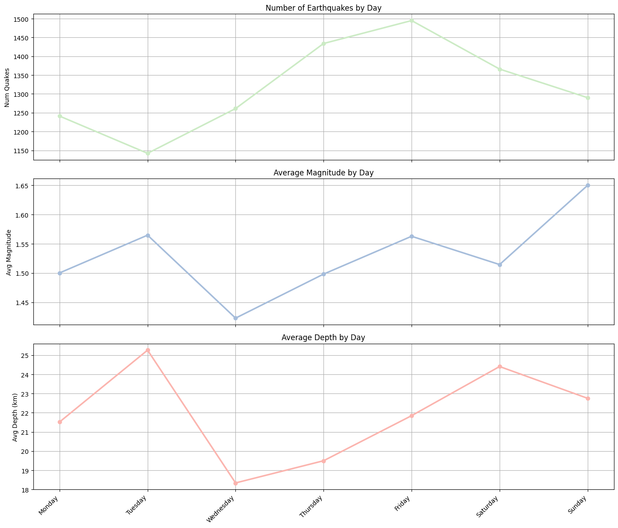

Slide 10
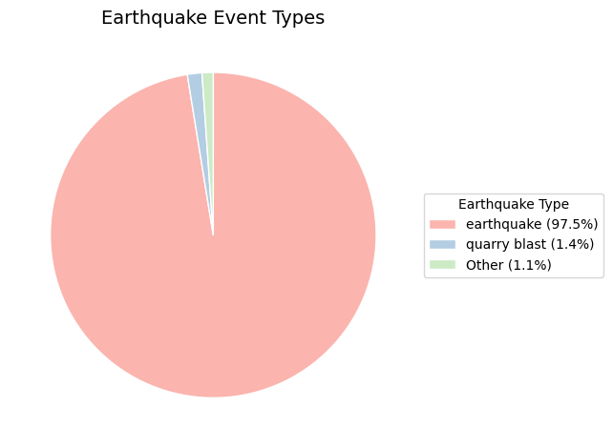
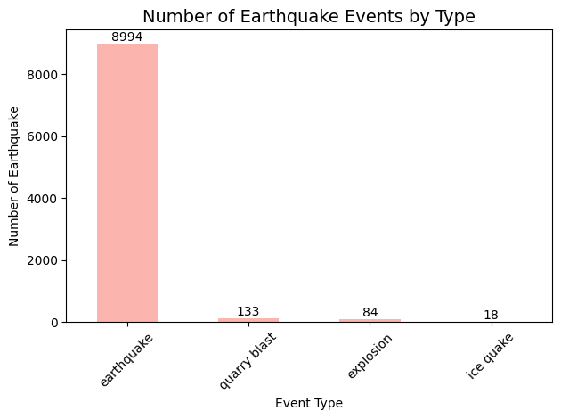

Slide 11
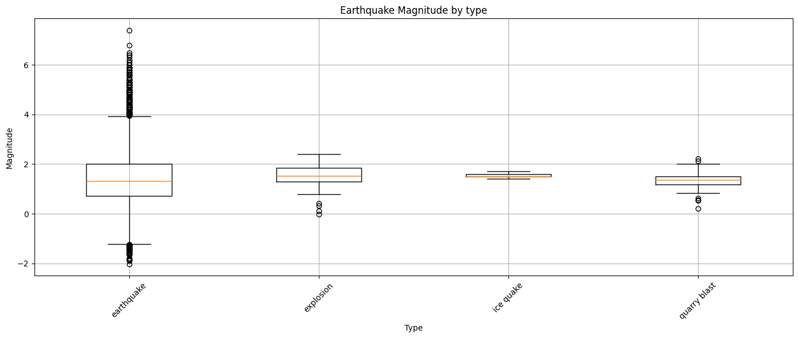

Slide 12
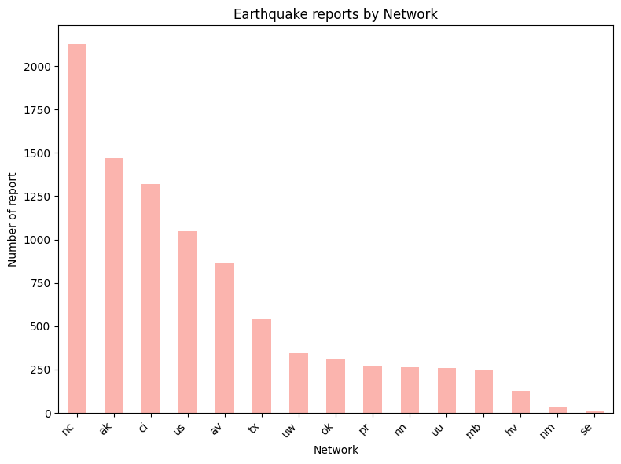
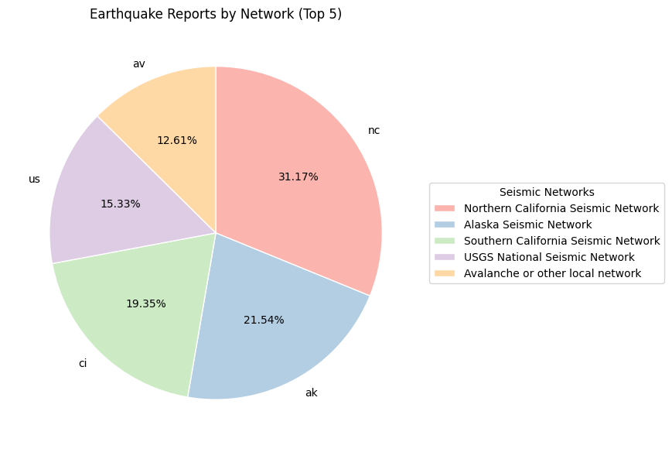
Credit : USGS.gov

Slide 13
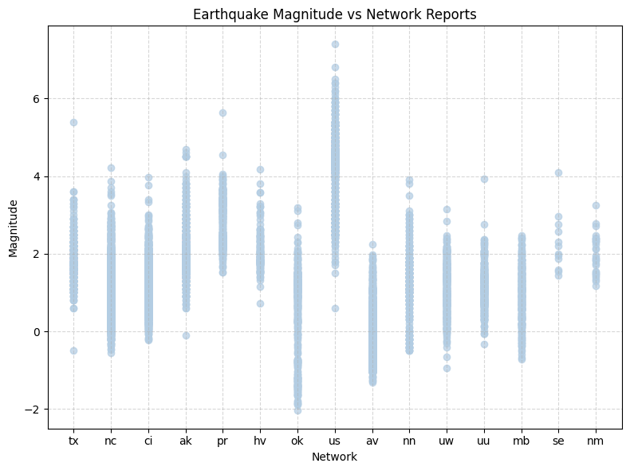

Slide 14
CONCLUSION
Alaska Peninsula and Northern California reported the highest number of earthquakes.
The vast majority of earthquakes fall within the magnitude range between 0 and 2, which are typically minor and often not felt by human.
Negative magnitude earthquake are likely detected due to highly sensitive modern instruments.
As the magnitude increases, the frequency of earthquakes drops sharply, this pattern is consistent with Gutenberg-Richter law, which states that earthquake frequency decreases exponentially with increasing magnitude.
The majority of events were classified under the earthquake type.

